Slide 1
Network Monitoring Fundamentals
Sharpe Curriculum

Slide 2
Agenda
Key terms and definitions
Goals and expectations
Baselining
Types of network management
Best Practices

Slide 3
Before we talk about fundamentals…
Some key terms you should know and understand:
Network management – we’re talking about managing/monitoring IT infrastructure to include routers, switches, firewalls, servers, applications, circuits, etc.
Fault – when something is down or unavailable.
Availability – percentage of time stuff is not down and is working – i.e., not in fault status.
NMS – Network Management System
Baseline – a measurement of current performance

Slide 4
Goals and Expectations
Why are you investigating network management? Some common answers…
Don’t have a system in place today.
Had an outage that the current system didn’t detect…
Current system is too expensive.
Current system doesn’t work.
Need to improve network availability.
Need to improve network performance.

Slide 5
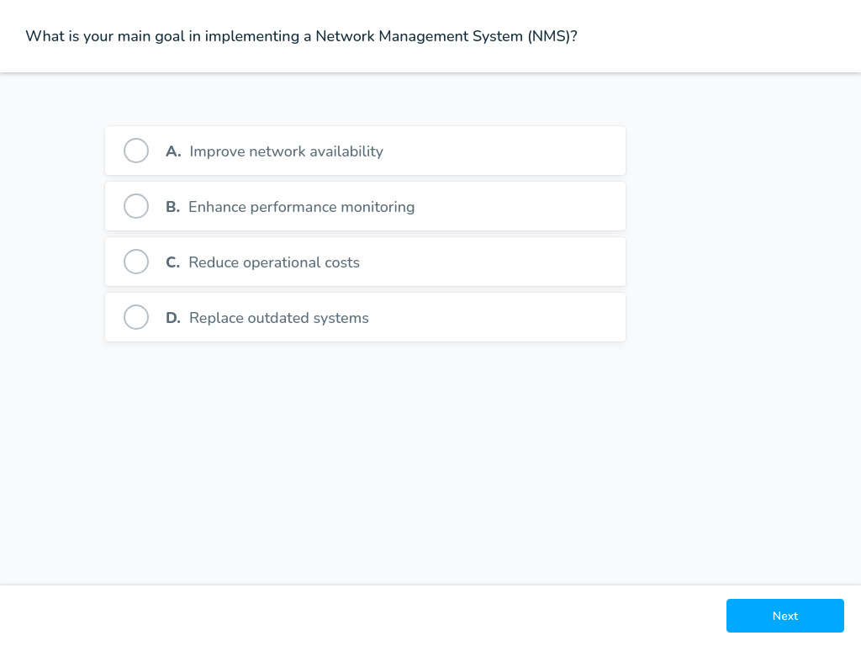
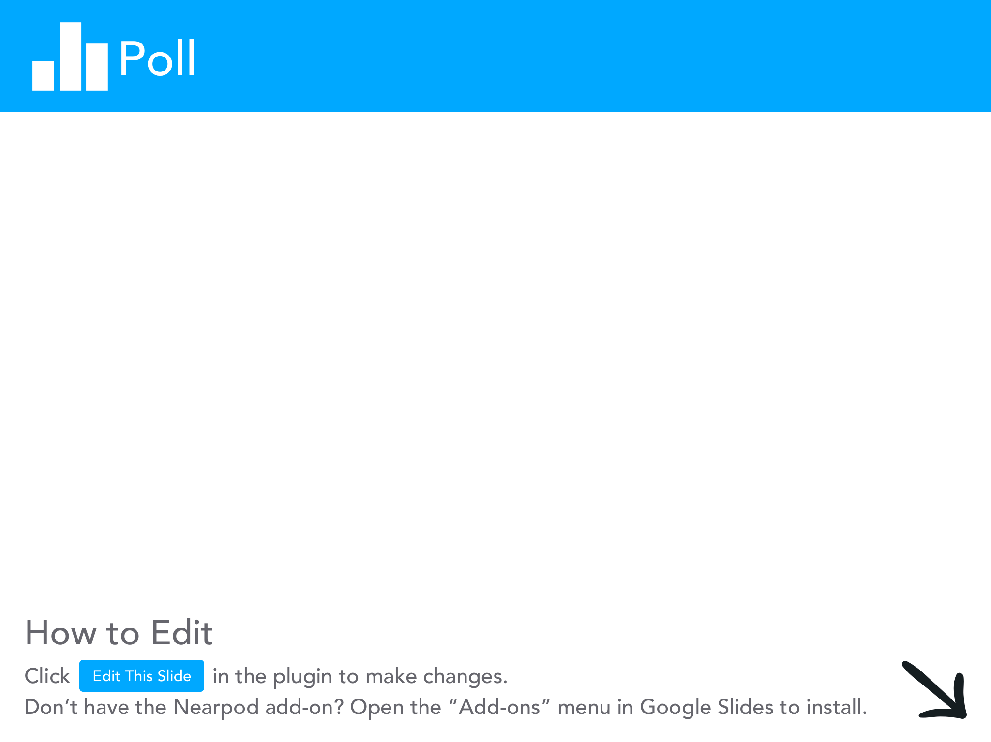

Slide 6
Goals and Expectations
Some things an NMS won’t help you with…
You don’t know how to configure devices on your network.
You have devices or service providers that are unreliable.
You need to deploy new applications to your end users.
Your boss is unmanageable.

Slide 7
Baselines – Fundamental #1
“If you don’t know where you started, how will you know how far you’ve come?”
Baselining the network is the first step in any successful network management project.

Slide 8
Baselines
Some important things to baseline:
Availability
Application Performance
Network congestion
User reported issues
Even if you don’t have good baselines:
Document your goals
Estimate current performance

Slide 9
Types of Network Management
Fault
Configuration
Accounting
Performance
Security
F-C-A-P-S

Slide 10
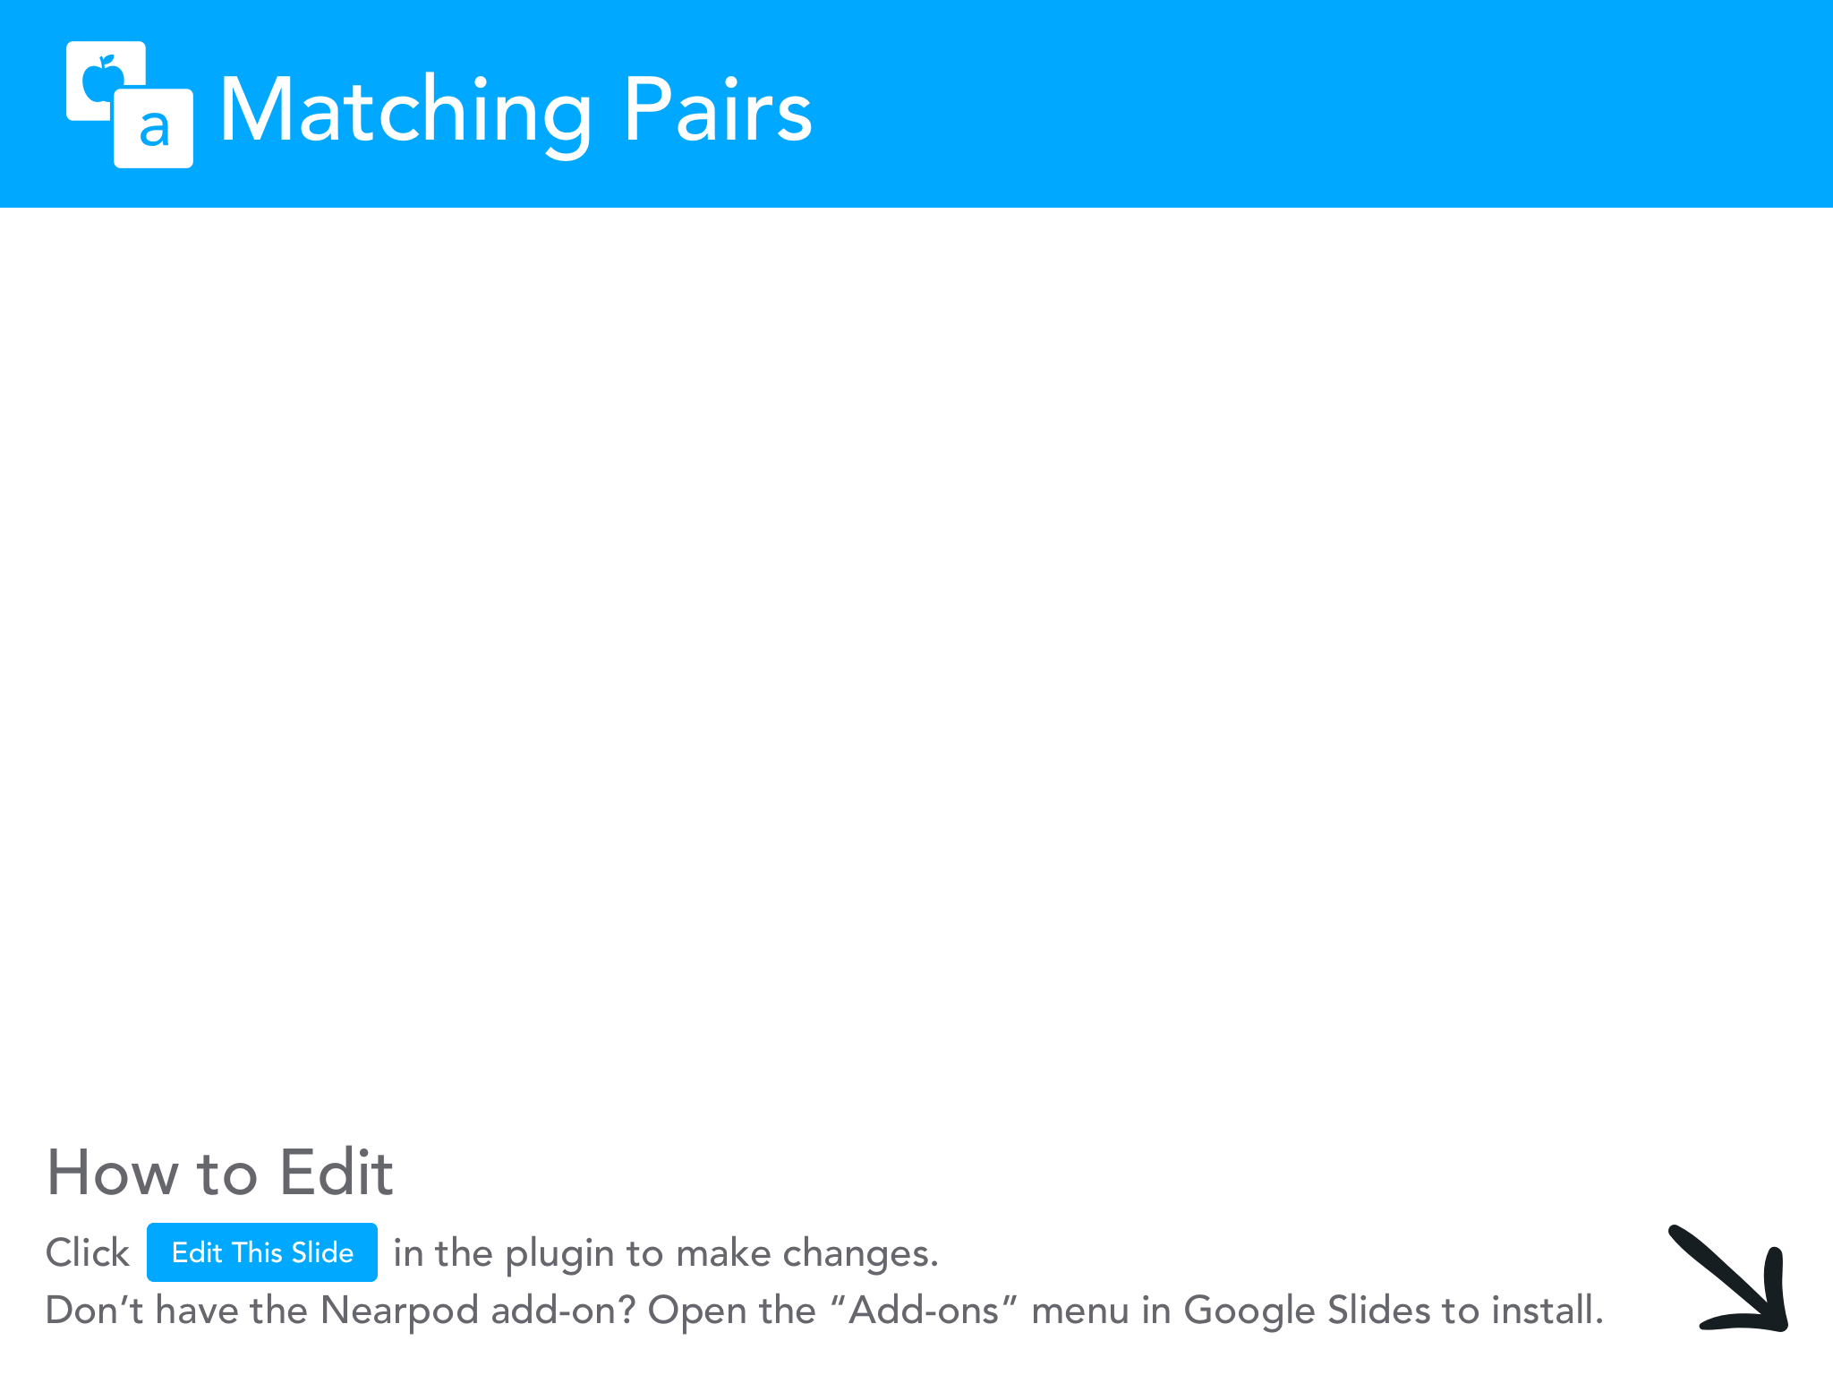
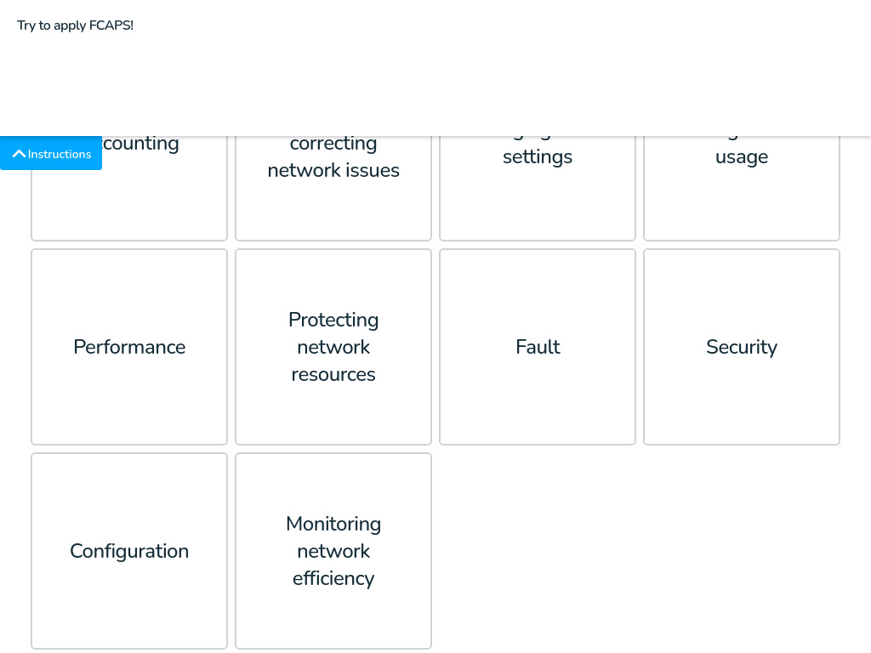

Slide 11
Basic Fault Monitoring
Goals:
Stop the phone calls…
React more quickly to outages
Common solutions:
Ping tools (many times home grown)
Open source tools
Commercial applications

Slide 12
Fault Management Systems – How they work
Fault management systems do these things:
Ping devices (ICMP echo request) for status
Query devices with SNMP to check interface status
Send fault notifications (alerts) via e-mail or SMS
Display network issues on a topology map
Classic examples of fault management tools:
HP OpenView (Enterprise software)
Zenoss (open source)
ipMonitor (SolarWinds)

Slide 13
Performance Management
Performance management includes monitoring things like:
Server performance (CPU, memory, disk)
Router performance (CPU, memory, buffers)
Circuit performance (bandwidth utilization, errors)
Analysis of network traffic and congestion
Most user-reported faults today are actually performance problems…

Slide 14
Performance Management – How it works
Performance management systems:
Use SNMP to query MIBs on devices for information
Run user experience monitors to evaluate end-to-end application performance
Use NetFlow (and other flow protocols) to do traffic analysis
The best NMS do both fault and performance management together, seamlessly

Slide 15
Top 5 Best Practices
#5 – Define your business objectives before beginning your network management strategy & deployment
#4 – Always baseline the network before you start making changes
#3 – Consider the true cost of application ownership
#2 – Get professional help if you feel like you’re over your head
#1 – Anything is better than doing nothing…

Slide 16

